Slide 1



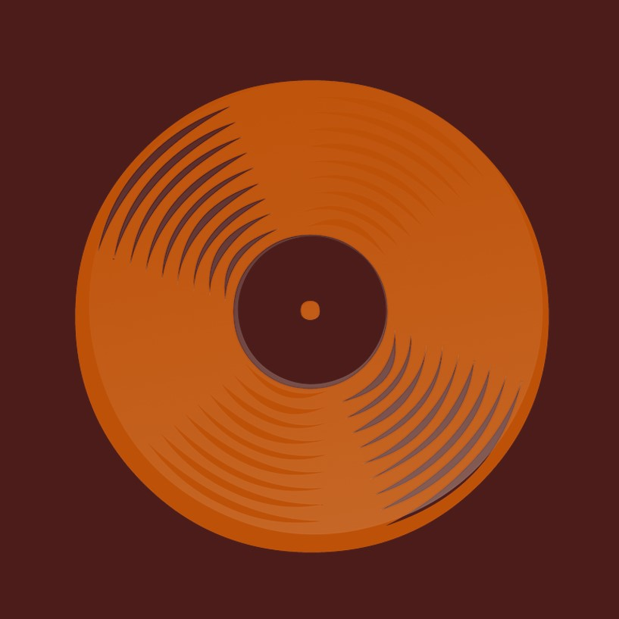
Get Started…
Network Music Streamer

Slide 2
What do you want to do? [click on links below]
Get an overview of the Streamer
Stream with Bluetooth
Stream with Wi-Fi
Connect the Streamer to Wi-Fi
Connect a Bluetooth speaker
Reconnect a Bluetooth speaker
Help - ”I cannot connect to Wi-Fi…”
Help - ”My phone will not pair to Streamer…” [Bluetooth]
Help - ”The Bluetooth speaker refuses to connect…”
Find out more about the Streamer’s Start Page
Find the IP address [Android only]
Trouble shooting

Slide 3
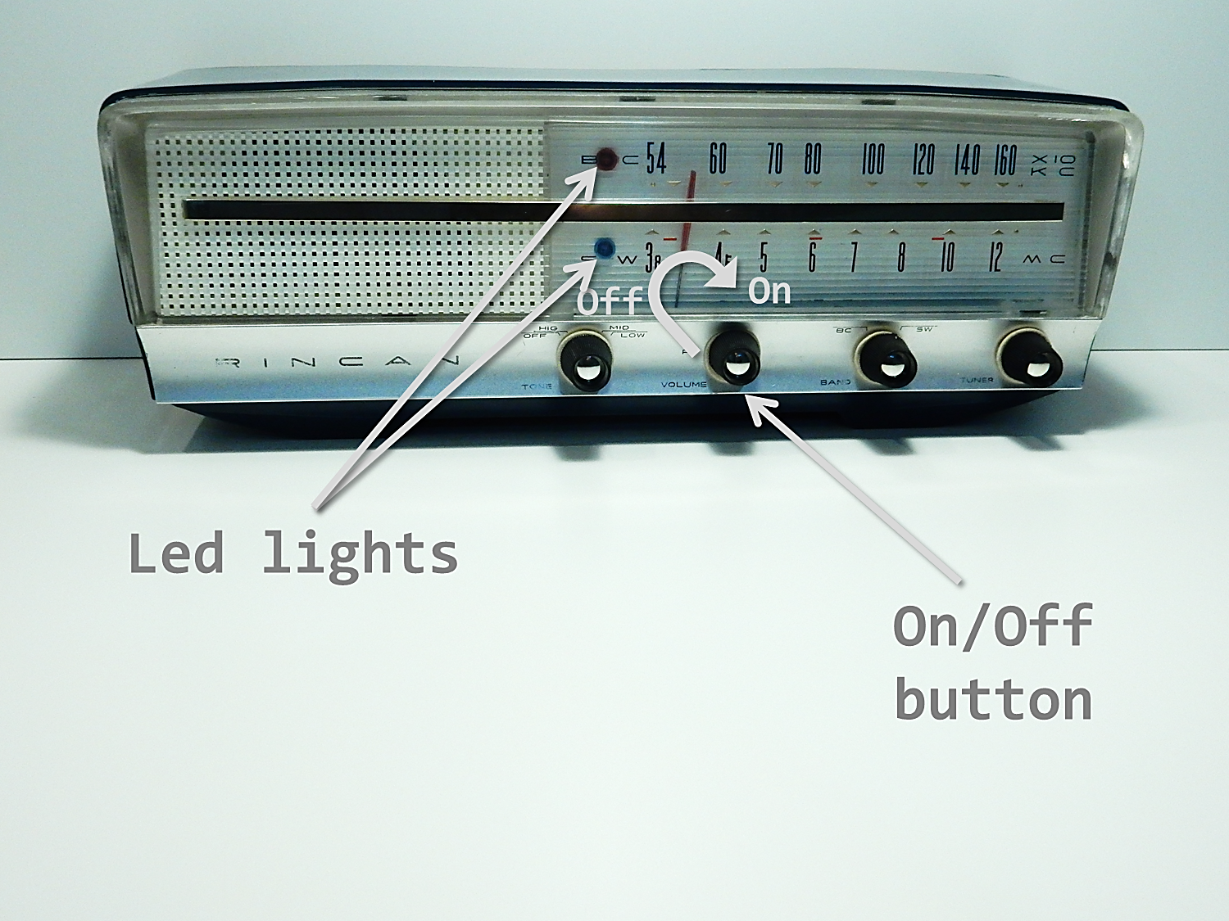
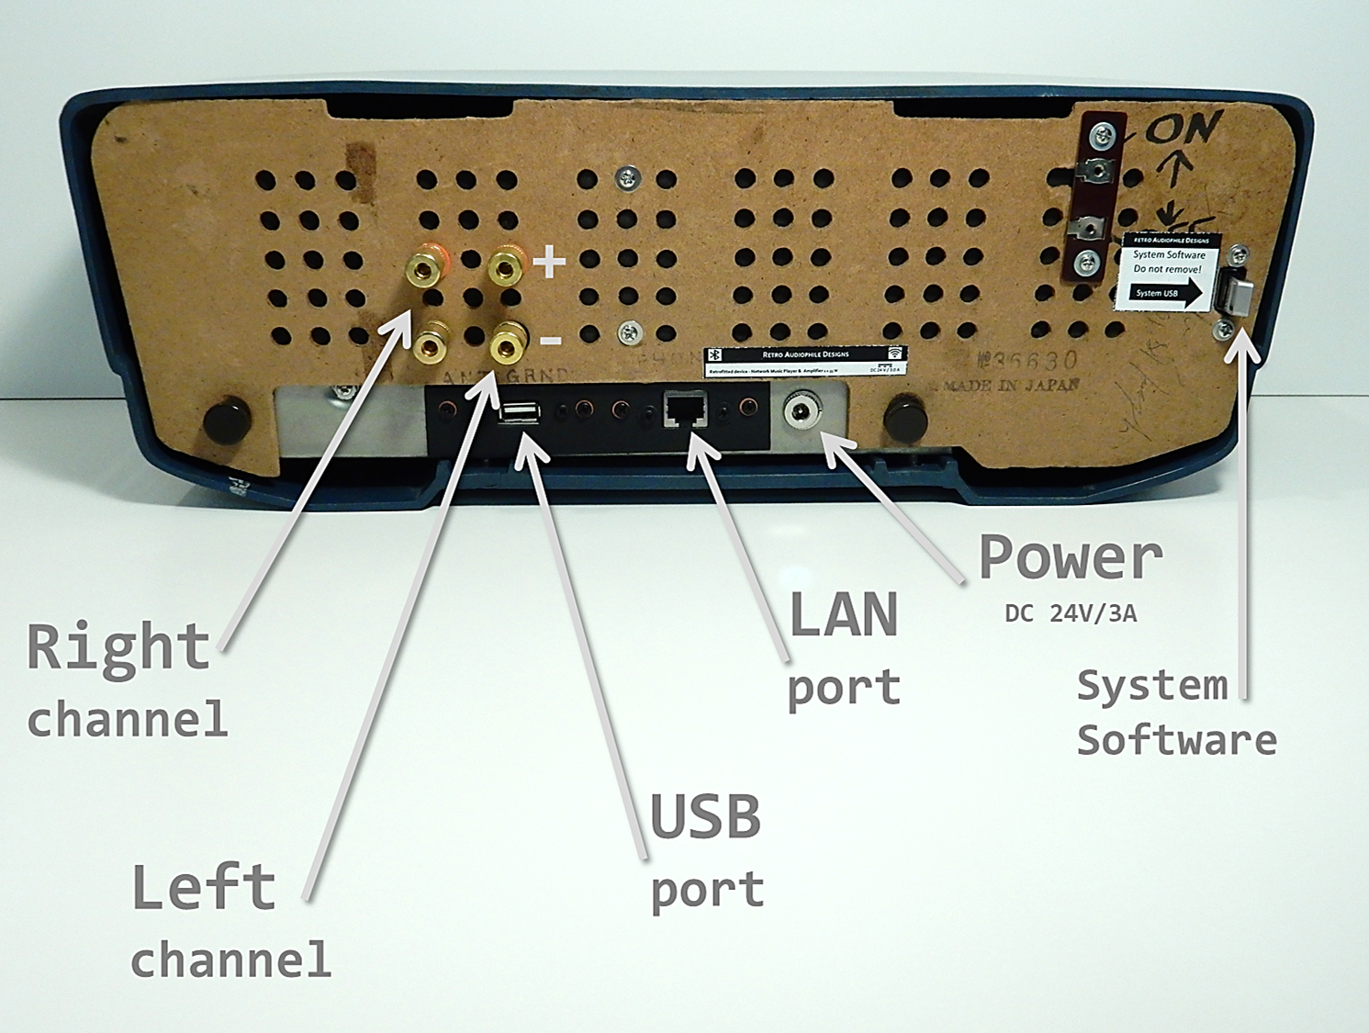
Overview:
[1 of 5]
Case:
Bang & Olufsen Beocord 8004
Serial Number:
AH014
[This is an example: every streamer looks different…]

Slide 4
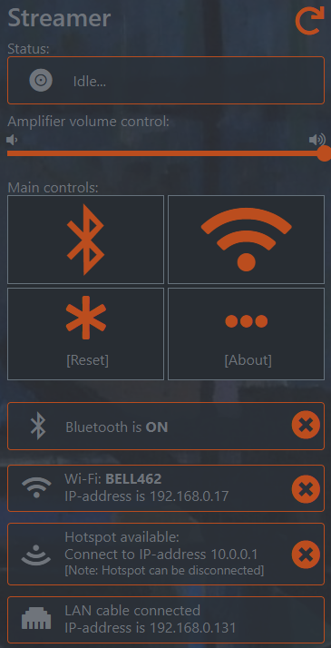
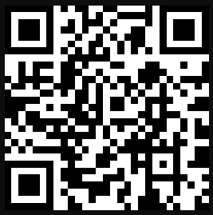
Overview:
[2 of 5]
The software is for managing the streamer
This is an app free system - you do not have to download and keep track of yet another app...
…instead the initial set up and settings like connections are managed through a web browser on your devices. In order to open the web pages, use the QR code. Or just enter http://streamer.local - if you have an Android device it might happen that you have to enter the actual IP address.
So, the only time you need the web pages are for set up, connecting a Bluetooth speaker and connect the streamer to your Wi-Fi .
The next pages will introduce you to: Start page, Network page and Bluetooth page
The streamer’s generic device name is Streamer.
You always control the streaming through your phone and apps.
QR code for http://streamer.local

Slide 5
[3 of 5]
Overview:
Start
Page
the Start page
The Start Page gives you an overview of what is happening with the streamer, what is going on…
You can click on the four main controls and open other streamer pages in order to do settings, reset or look at the About page
Below the main controls there are some additional information about how the streamer is currently connected.
Access the start page:
Or enter the IP address*.
connect to Wi-Fi or disconnect
About page, more information
http://streamer.local
pair and connect Bluetooth speakers or disconnect
*) If you are using an Android device your browser may understand http://streamer.local and open the start page as intended. Unfortunately, some older versions of Android OS are not capable of resolving a local web address. Instead, you have to use the IP address of the player instead. How to find the IP address is described here.
reset streaming and Bluetooth, the streamer becomes idle

Slide 6
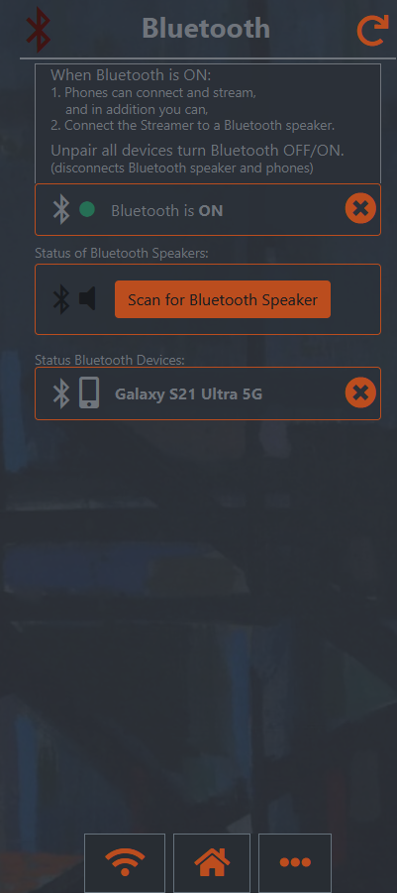
[4 of 5]
Overview
Bluetooth
Page
the Bluetooth page
The Bluetooth page is used for managing different aspect of Bluetooth. Turn the Bluetooth access to the streamer on or off, connect a Bluetooth speaker and deal with Bluetooth devices (e.g. smart phones) that are connected at the moment.
Bluetooth is on
no Bluetooth speakers are paired or connected,
but you can scan
for a speaker
there is a smartphone
paired and connected,
ready to stream…

Slide 7
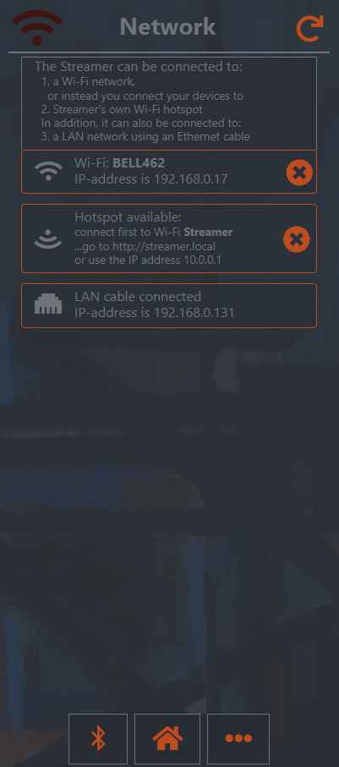
[5 of 5]
Overview
Network
Page
connected to Wi-Fi
the network page
The most common option is that the streamer is connected to your Wi-Fi network.
The local access point, the Hotspot, is mainly used for set up in order to find your home Wi-Fi network.
There is always an option to use a LAN cable.
Note: You can access… the Bluetooth page, the Start page, the About page, as well.
the local Access Point, the Hotspot, is on
there is also a LAN cable
connected to the Streamer

Slide 8
Stream with Bluetooth
Bluetooth Page
1
Go to settings on your smart phone, turn on Bluetooth and scan for Bluetooth devices. Streamer will be one of them. From your phone pair and connect to Streamer. (The streamer’s generic device name is Streamer for Bluetooth, Wi-Fi, Airplay,….)
Important: the streamer should be idle in order to be connected.
If you cannot find Streamer – scan again. Sometimes several scans are required.
If they do not connect – unpair Streamer and connect again, sometimes that is needed…
As long as the phone and the streamer are paired they can easily be reconnected again.
Open up an app and start streaming. Remember to check the volume on your device. The connection is also shown on the streamer’s Bluetooth Page
Optional: If you want to you, can always check if the Bluetooth is on by opening the streamer’s Start page or Bluetooth page.
Note: normally you do not use the streamer web pages – you use your phone and its apps to manage streaming.
3
connected
to Streamer
2
3

Slide 9
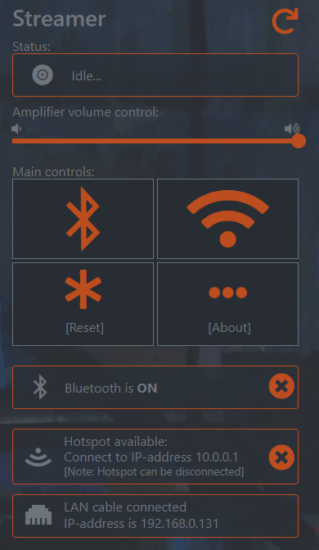
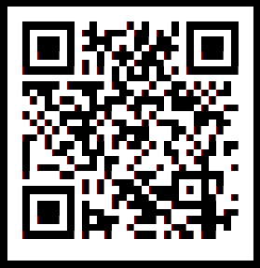
Connect to Wi-Fi
[1 of 6]
Start
Page
1
Find the Wi-Fi network Streamer
Scan for the Wi-Fi network with the SSID name Streamer, or use the QR code. The Wi-Fi network called Streamer is the Streamer’s own Wi-Fi network, it is not a part of your home network. It is a solitaire Wi-Fi access point - a hotspot (it is only used for setup).
3
[click]
2
Connect your phone to Streamer Wi-Fi network
Connect to the Streamer Hotspot by using the password retrostreamer. Wait for a while… …and eventually the connection will be established.
Use the QR code or if you use an iPhone or Windows, Mac, Linux computer just enter the url: http://streamer.local in your web browser of choice, then the start page will open.
Or try 10.0.0.1 (the ip address).
If you use an Android device you might have to enter the ip address 10.0.0.1. …and the start page of the Streamer will open.
QR code: Hotspot
IP address is:
10.0.0.1
Password: retrostreamer
3
Go to the Network page
In order to connect the streamer to your Wi-Fi network go to the Network page by clicking on the Wi-Fi button at top right, besides the Bluetooth button.
QR code:
http://streamer.local

Slide 10
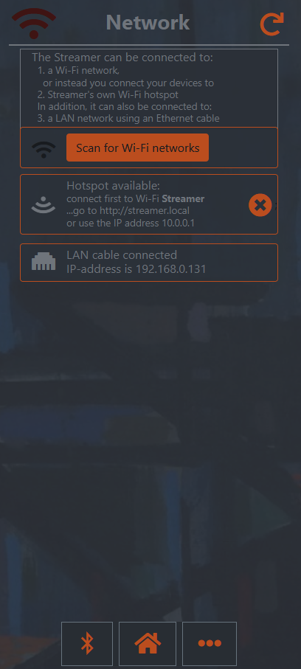
Connect to Wi-Fi
[2 of 6]
4
4
Network
Page
[click]
The Network page – scan for your Wi-Fi
On the Network page click on the orange button marked “Scan for Wi-Fi networks”. Wait for a few seconds.
Note:
Your phone is connected to the local access point, the Hotspot, at IP address 10.0.0.1.

Slide 11
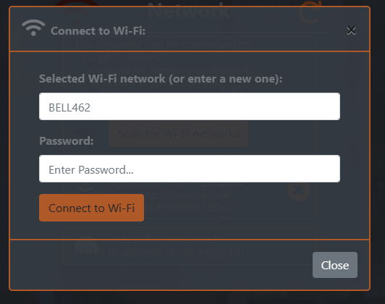
Connect to Wi-Fi
[3 of 6]
Network
Pop-up
[enter]
5
Choose your home Wi-Fi network
Your home network will show up in the pop-up list of available networks. Click on your network.
[Not shown].
6
6
enter the password and connect…
Enter the password of your home Wi-Fi and click on the orange button marked “Connect to Wi-Fi”.
Note:
Your phone is still connected to the local access point, the Hotspot, at IP address 10.0.0.1.
[click]

Slide 12
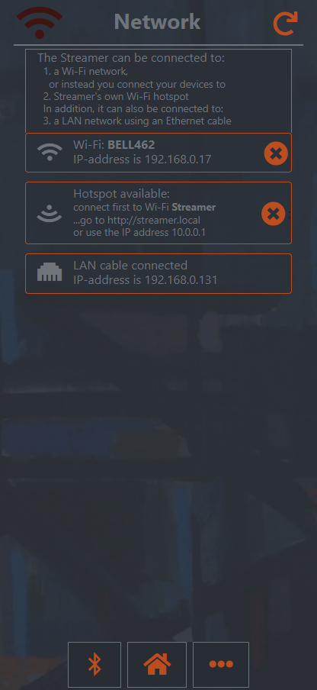
Connect to Wi-Fi
[4 of 6]
Network
Page
8
7
Wait until the streamer gets connected…
The connection will take a while and if it fails check the chosen SSID and the password. Try again.
Connected
Eventually the streamer will confirm a successful connection to your Wi-Fi network.
Note
Even if the Streamer now is connected to your home Wi-Fi network - your phone is still connected to the local access point, the Hotspot, at IP address 10.0.0.1.
8

Slide 13
Connect to Wi-Fi
[5 of 6]
9
Network
Page
The phone is still connected to the ”10.0.0.1” page
When the streamer gets connected to your home network your phone is connected to the Hotspot (the streamer’s own Wi-Fi network) at this moment and you are still looking at the 10.0.0.1 page. Now there are actually two Wi-Fi connections: your home network and the Hotspot.
9
!
Remember to reconnect your phone
Restart your smart phone and then connect again to your home Wi-Fi network. Done!
It is also important to restart the streamer. In this way it is easier for the network router to detect the changes.
After the restarts you can stream music to the streamer from your phone over Wi-Fi. Read more here.

Slide 14
Connect to Wi-Fi with a LAN cable
Help with Wi-Fi:
[6 of 6]
1
It can be a little bit difficult to connect via 10.0.0.1
Connecting first to the local Wi-Fi network of the streamer and then reconnect to your home work might be confusing. There is another way that works too…
Attach a LAN cable
Place the streamer within a decent cable distance from the Wi-Fi router. Turn on the streamer and wait for about 2 - 3 minutes (the boot time). Insert a LAN cable (Ethernet patch cable) into the LAN-port in the back (see overview page) and the other end in an available LAN-port of your router. The streamer gets immediately connected to your home network. Open the Start page.
Go to the Wi-Fi page – enter SSID and password
On the Network page click on the orange button marked “Scan for Wi-Fi”. Choose your Wi-Fi network from the list that pops up, i.e. the SSID, and enter the password of your network in the next pop-up window. Done!
Detach the LAN cable
When the streamer finally is connected to Wi-Fi it is recommended that you first turn off the streamer and then detach the LAN cable. After that, wait at least 15 seconds and turn on the streamer again. In this way it is easier for the network router to detect the changes. You might need to restart your phone to faster update your browser.
Start
Page
2
the LAN cable is attached
http://player.local
3
2

Slide 15
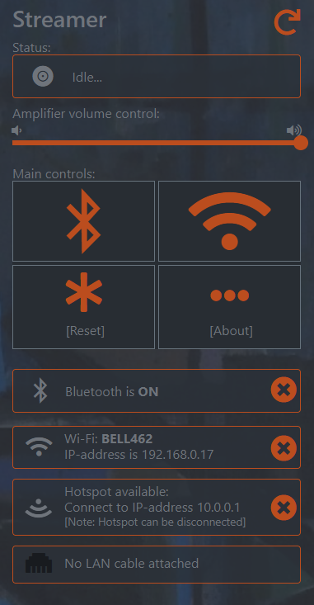


Stream with Wi-Fi
Start
Page
2
1
… stream, when connected to Wi-Fi
After you successfully connected the streamer to your home Wi-Fi network you can start streaming, here are some options:
Open up your Spotify app on your Android device or iPhone/iPad or computer and in the Spotify app settings choose Streamer as the output device. (Requires a premium account). The volume is set to 25% - adjust the volume on your device.
Open up any other music app on your iPhone/iPad/Mac and in the Airplay menu choose Streamer as the output device. The volume is the volume set on your device.
Note that all aspects of the streaming is done on your phone (e.g. setting the volume, start and stop). You do not have to open up the Start page (i.e. http://player.local).
Optional: If you want to you, can always check if the streamer is streaming or not on the Start page. Note: normally you only use the streamer web pages for settings.
2

Slide 16
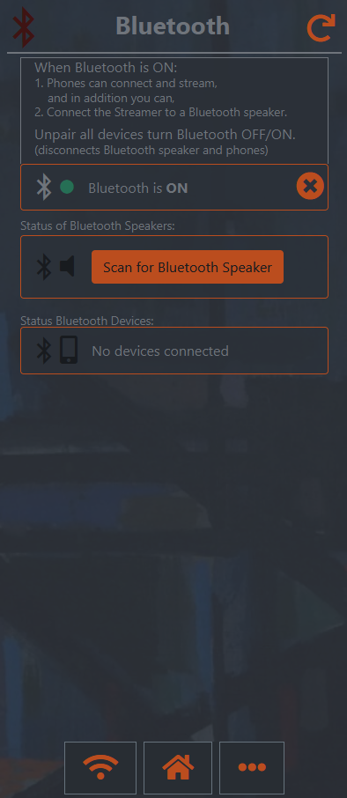
Connect a Bluetooth speaker
[1 of 3]
1
Check the Bluetooth speaker first
Be sure that the Bluetooth speaker is on and that it is ready to connect. Often it flashes its lights and makes some beep noises when it is ready.
Bluetooth Page
2
2
Scan for a Bluetooth speaker
Open up the Start page with the QR code or enter: http://player.local, go to the Bluetooth page and click on the orange button marked “Scan for Bluetooth Speaker”.
The scanning will take quite a while – about 40 s.
Wait patiently. Wait, wait…
[click]
3

Slide 17
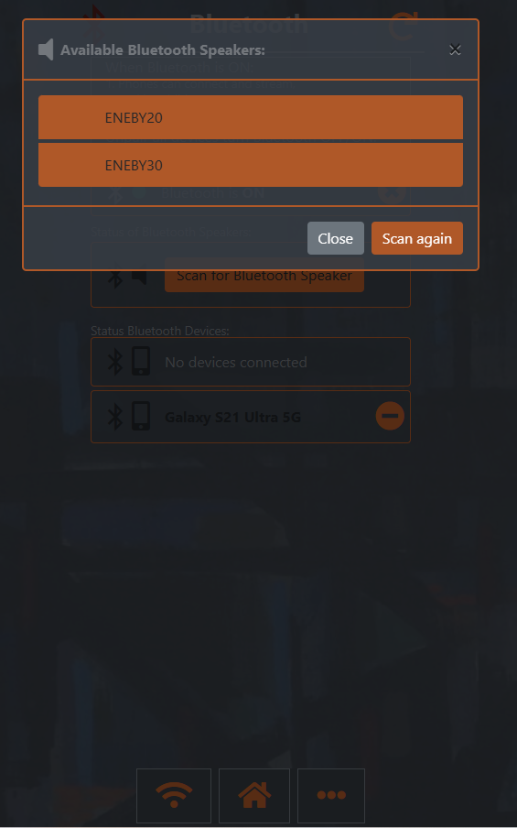
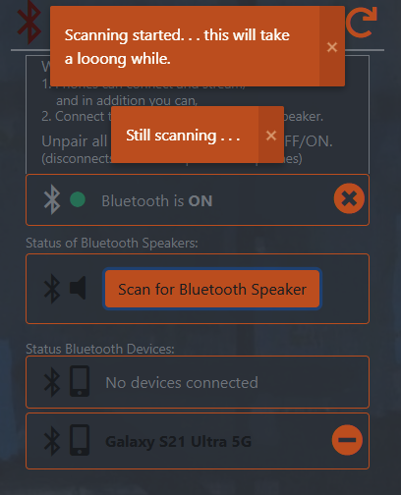
Connect a Bluetooth speaker
[2 of 3]
5
4
Wait patiently. Wait, wait…
Bluetooth Page
5
Choose a Bluetooth speaker
In the pop-up menu pick the speaker you want to connect to… [click on the name of the speaker]
...then the streamer will become connected and the Bluetooth Page will also be updated with the new speaker connection.
Important: any ongoing streaming will be reset!
4
[notifications]
[click on the name of one of the speakers]
[wait]

Slide 18
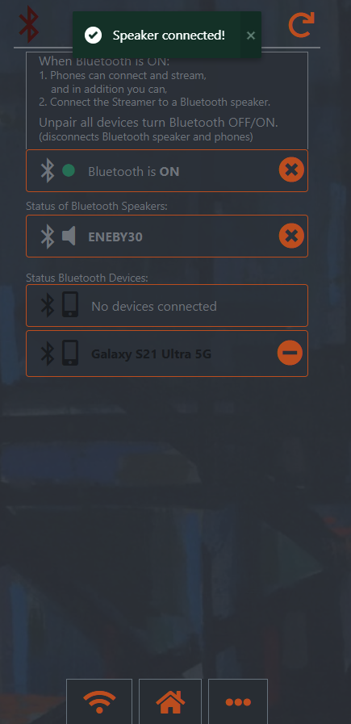
Connect a Bluetooth speaker
[3 of 3]
6
The Bluetooth speaker is connected
When a Bluetooth speaker has been connected it is shown on the Bluetooth page.
Click on the orange cross button to disconnect.
Or turn off the Bluetooth speaker.
Connected and/or paired phones are also shown The Bluetooth pages displays all connected and/or paired devices, not only speakers.
disconnect the speaker
Bluetooth Page
Bluetooth Page
6
!
unpair a a phone
connected!
7
a phone that is still paired, but not
connected

Slide 19
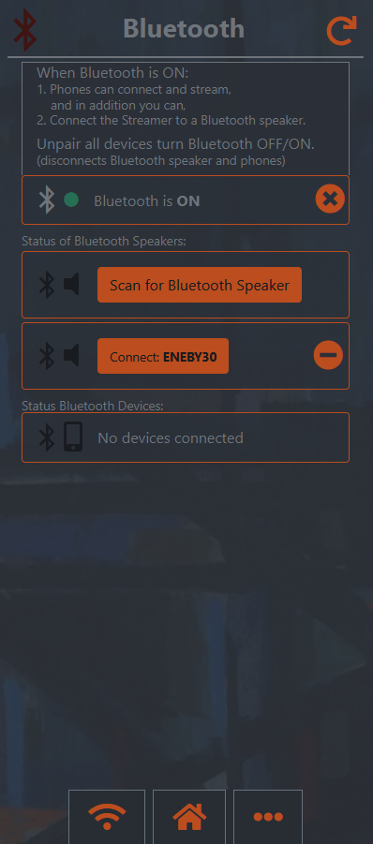
Reconnect a Bluetooth speaker
1
reconnect without scanning
If a Bluetooth speaker has been connected and disconnected it is still shown on the Bluetooth page (as paired).
In this case there is no Bluetooth speaker connected, one speakers is paired.
Click on the orange button and the chosen speaker will be reconnected, without scanning.
Or even better, just turn on the speaker and it will connect since the speaker and the streamer is already paired.
You can unpair (remove) a disconnected speaker. To reconnect you then have to scan again.
Bluetooth Page
1
2
[click]
reconnect the speaker
!
unpair the speaker
2

Slide 20
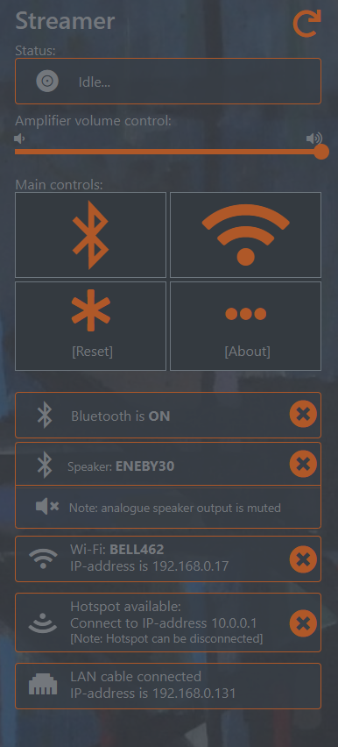
Start page
refresh page
current status, it is idling
Start
page
the Start page
The Start Page gives you an overview of what is happening with the streamer, what is going on…
You always control the streaming through your phone and apps.
adjust volume
should be 100%
http://player.local
connect a Bluetooth speaker or disconnect
connect or disconnect Wi-Fi
reset streaming and Bluetooth,
streamer becomes idle
more information…
turnoff Bluetooth
Bluetooth works
there is a Bluetooth speaker connected
connected to Wi-Fi
the Hotspot is still up
a LAN cable is attached
disconnect speaker
disconnect Wi-Fi
turn off the Hotspot

Slide 21

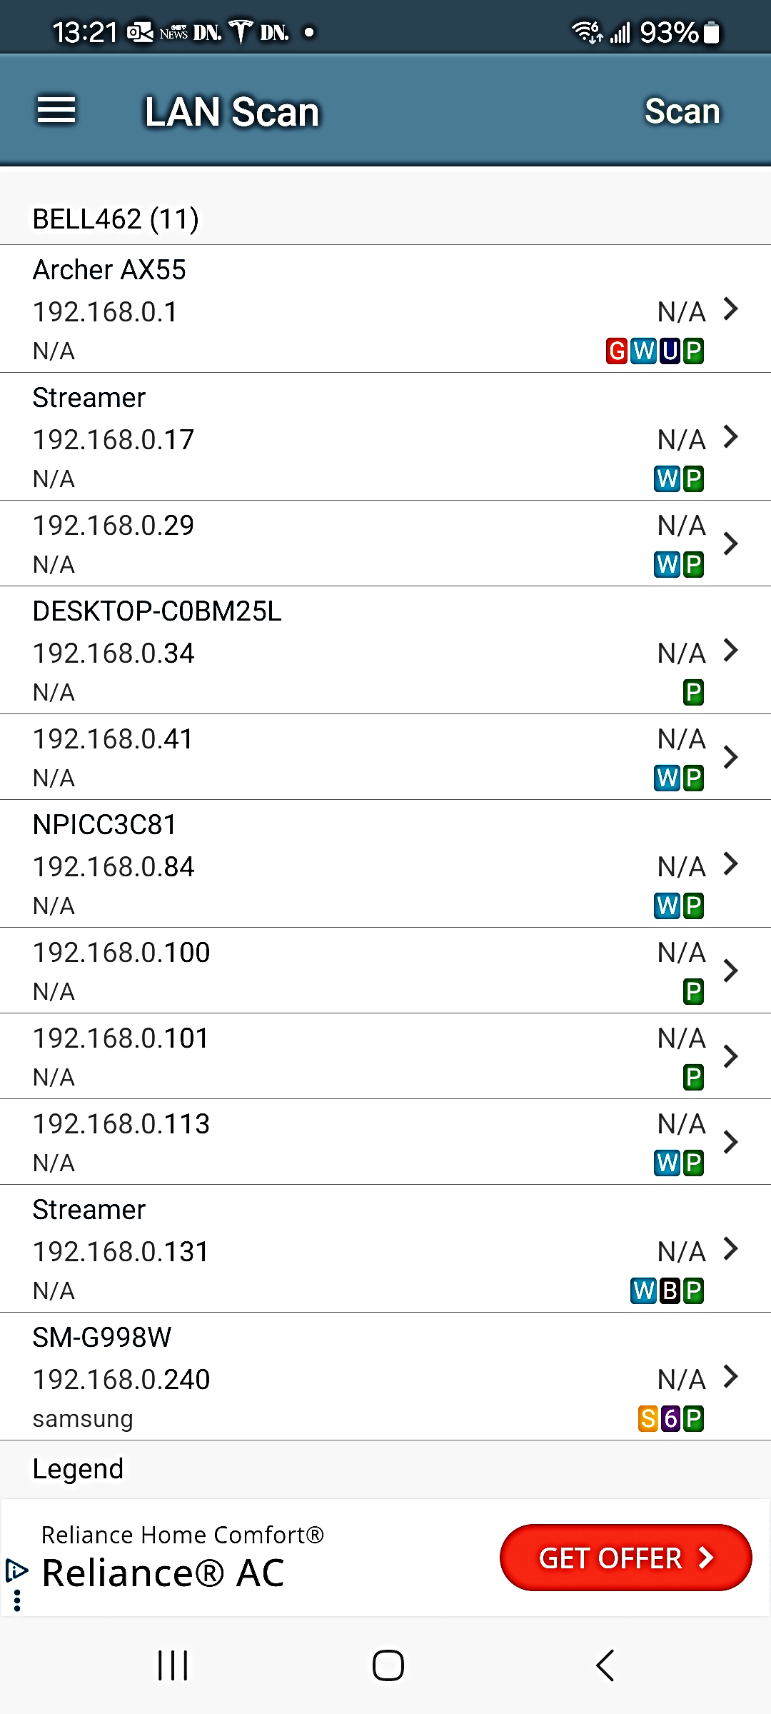
[Android only] Find the IP address
the Net Analyzer app
Open the Start Page with an Android device
As mentioned earlier, if you are using an Android device your browser may not understand the QR code or the address http://streamer.local and will not find the start page as expected…
Unfortunately, some older versions of Android OS are not capable of resolving a local web address. Instead, you have to use the IP address that is assigned to the streamer by your home network.
Scan for the IP address – use a network scanner app
We recommend Net Analyzer*, since it is easy to use, well-proven and the basic version is free, the free version of the IP scanner can be downloaded on the Google App Store.
Scan with the Net Analyzer
This is how to find the IP address using Net Analyzer:
Open the app and in the menu go to “LAN Scan”. Click on “Scan” in the upper right corner.
Look for Streamer and note the IP address.
Note: you can find the IP address from another non-Android device where http://player.local works by open up the Network Page or Start Page and check how the streamer is connected.
1
Net Analyzer
Streamer Wi-Fi connection
Streamer LAN cable connection
1
1
2
*) More information: https://techet.net/netanalyzer/

Slide 22
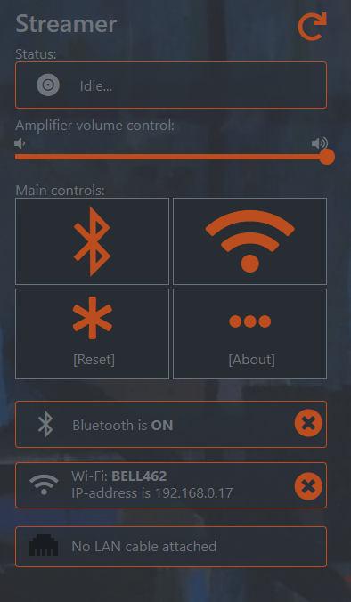
Bluetooth speaker problems
1
”Cannot connect a Bluetooth speaker”
The reason that a connection attempt fails is often because the speaker and the streamer cannot be “paired”. The two Bluetooth devices need to agree to be “paired” before they can connect.
Also be sure that the speaker is not used by someone else or that it is paired to another bluetooth device.
Turn off the Bluetooth speaker, wait for 10 seconds and then turn on the speaker again. Try once more. If that does not work try 2 below.
Turn off the Bluetooth speaker.
Go to the Start page and click on “Reset”. The streamer will then unpair and disconnect itself from all previous connected Bluetooth devices. Wait a few seconds and turn on the Bluetooth speaker, scan and try again to connect.
Bluetooth Page
http://player.local
2
[click]
2
reset
streamer

Slide 23
Bluetooth streaming problems
”Cannot connect to the streamer”
The reason that a connection attempt fails is often because the phone and the streamer cannot be “paired”. The two Bluetooth devices need to agree to be “paired” before they can connect.
On your phone, first unpair the streamer (i.e. device name Streamer) and do a scan or turn off and on the Bluetooth service on your phone. Note: the streamer has to be idle – you cannot connect if it is streaming!
Depending on your phone, when the streamer gets paired it might be connected as well or it might not. If it just got paired connect to the streamer. If that does not work try 1 - 2 below.
In order to reset the streamer, go to the Start page and click on “Reset” The streamer will then unpair and disconnect itself from all previous connected Bluetooth devices. Wait a few seconds and try again.
Turn off Bluetooth on your phone, turn it on and try again to pair and connect.
Start Page
http://player.local
1
[click]
1
reset
streamer
2

Slide 24
Troubleshooting
1
Restart the streamer
If Bluetooth, Spotify, Airplay or Bluetooth streaming does not work properly reset the streaming by open the Start Page and click on the button marked “Reset”.
Start Page
http://player.local
2
Option: turn off and turn on the streamer
If the streamer seems unresponsive or the pages are frozen then turn off the streamer, wait for 15 seconds and turn on again.
1
[click]
reset
streamer

Slide 25
Copyright 2017 - 2024 Retro Audiophile Designs
All rights reserved. No part of this work may be reproduced or transmitted in any form or by any means, electronic or mechanical, including photocopying, recording, or by any information storage or retrieval system, without the prior written permission of the copyright owner.
Version: revision Git Hub.

